Slide 1
Query Store, Who is the fairest in the land?
Deepthi Goguri

Slide 2

Deepthi Goguri
Database Administrator
Data Platform MVP
Co-Organizer for DEI User Group, Microsoft Data and AI South Florida User Group, DATA TGIF
Volunteer for Data Platform WIT User Group
Loves Arts and Crafts
Twitter: @dbanuggets
Blog: https://dbanuggets.com/
Linkedin: https://www.linkedin.com/in/deepthigoguri/

Slide 3
Overview
What is Query Store?
How it works?
Latest features in SQL Server 2022
Query Store Hints
Available on secondary replicas
Supporting IQP features
Parameter Sensitive Plan (PSP) Optimization
Degree of Parallelism (DOP) Feedback
Cardinality Estimate Feedback

Slide 4

What is Query Store?

Slide 5
What is Query Store?
Introduced in SQL Server 2016
Captures query performance statistics
Option to choose optimal plan
Database level option only
Disabled by default
SQL Server and Azure Synapse Analytics database
Enabled by default (Azure SQL database)
Cannot be enabled on master or tempdb

Slide 6

How Query Store Works?

Slide 7
Query
Are you running for the first time?
YES
NO
Compilation and Optimization
Plan in Cache?
NO
YES
Is this plan the same forced plan?
But wait, check for recompilation!
Alright, then take it from the plan cache!
CHECK
Oops, NO!
YES
1. Async
Query Text
Query Plan
Async
Plan Store
Query Store
Schema
Apply the forced plan
2. Run
In-Memory
Async
Query Executes
Async
Run time Stats
Runtime stats Store

Slide 8
Plan cache vs Query Store
Plan cache
Flushed out on every server restart
Stores latest plans
Evicted on memory pressure
Difficult to know why plan changed
Query Store
Retains the data (CLEANUP_POLICY)
Collects plans over time
Flush out intervals
Useful when troubleshooting performance problems

Slide 9
What data is collected?
SQL Server 2017+ includes wait stats information
CPU, IO, Memory
Duration, Logical Reads and Writes, Physical Reads, CLR Time, DOP, Row Count, Log Memory Used, Temp DB Memory Used, and Wait Time
History of the plans
Resource-consuming queries

Slide 10
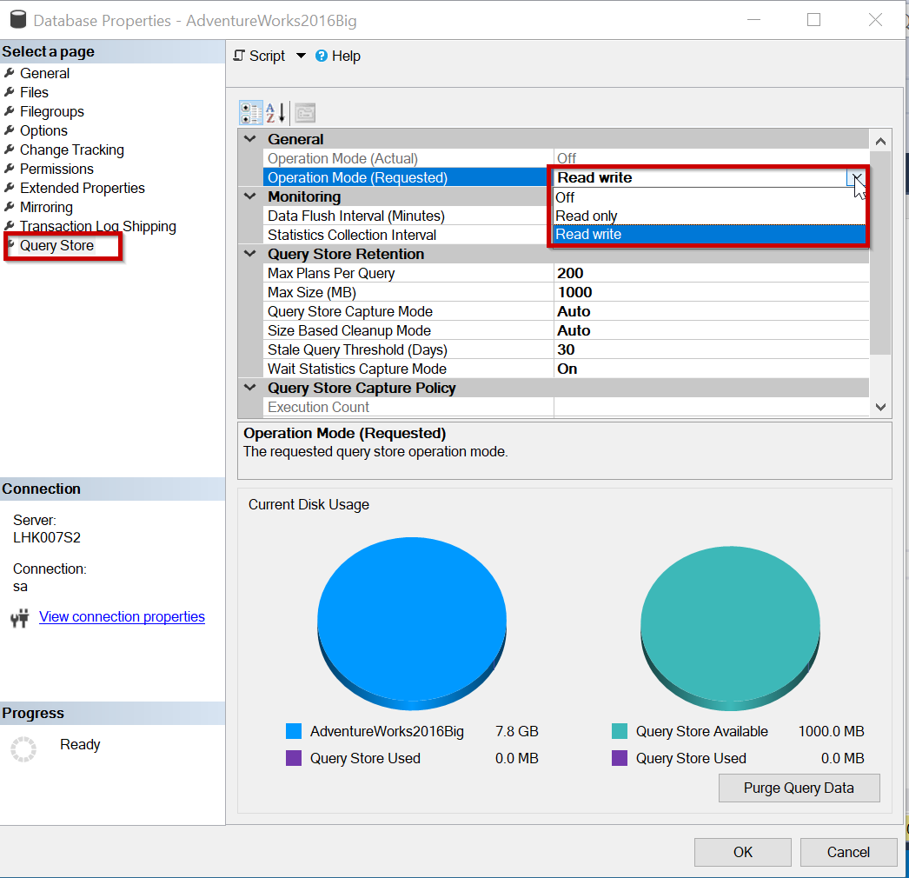
Query Store Operation Mode

Slide 11
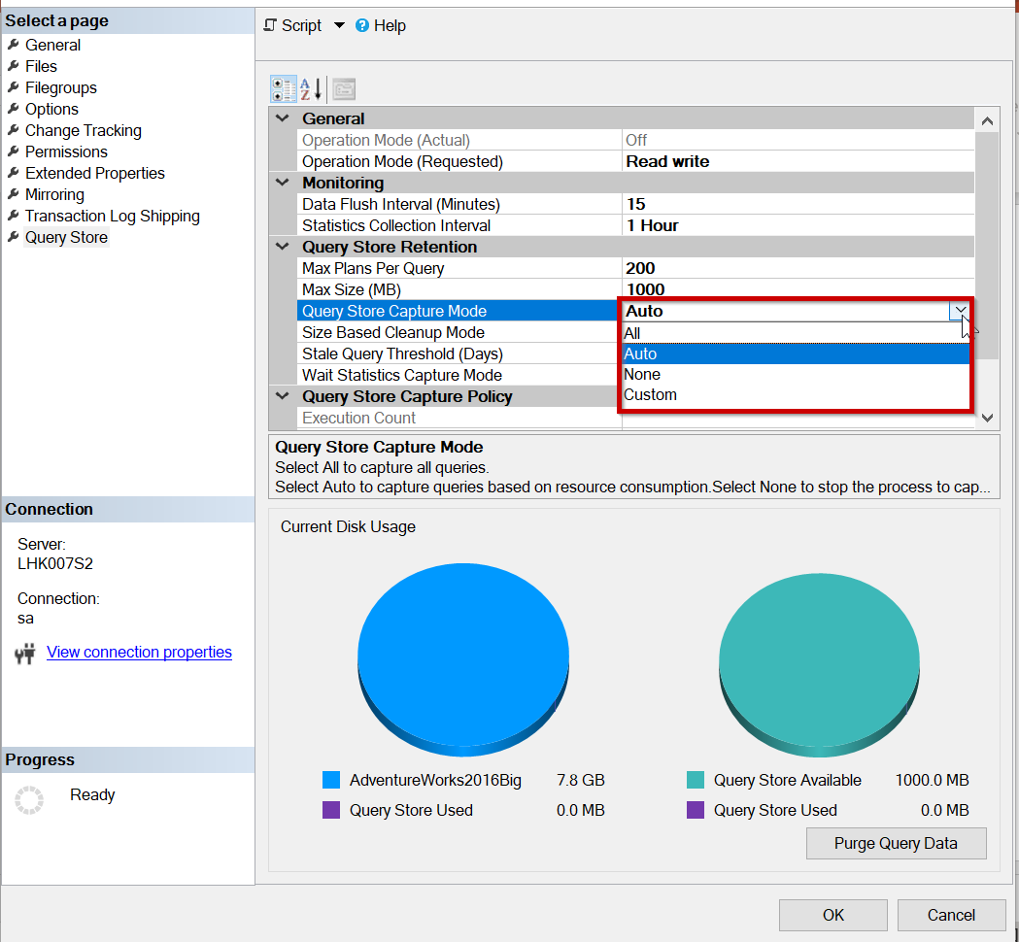
Query Store Capture Mode

Slide 12
Query Store benefits
Identify regressions due to plan changes
Quickly fixes non-optimal plan usage
Performance tuning
No changes needed to user applications or underlying code
Useful during the database upgrades

Slide 13
Plan Forcing

Slide 14
Plan Forcing
Just like the USE PLAN query hint
Optimizer uses the forced plan
If it fails, optimize in the regular way
Force using sp_query_store_force_plan
Unforce using sp_query_store_unforce_plan

Slide 15
Automatic plan correction

Slide 16
Automatic plan correction
SQL Server 2017 and above
Continuous monitoring for plan regression
Adjust accordingly by forcing/unforcing
Enable using T-SQL or using the Azure portal
T-SQL
ALTER DATABASE Databasename
SET AUTOMATIC_TUNING (FORCE_LAST_GOOD_PLAN = ON );
sys.dm_db_tuning_recommendations

Slide 17
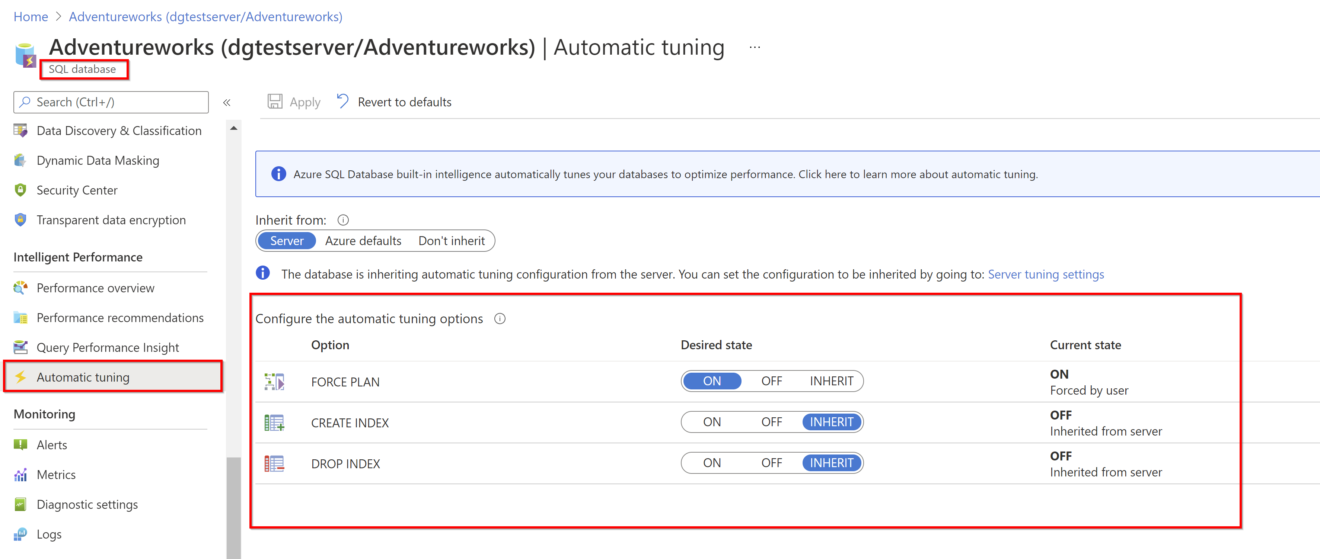
Azure portal: Enable FORCE PLAN

Slide 18

DEMO

Slide 19

SQL Server 2022 QS Advancements

Slide 20
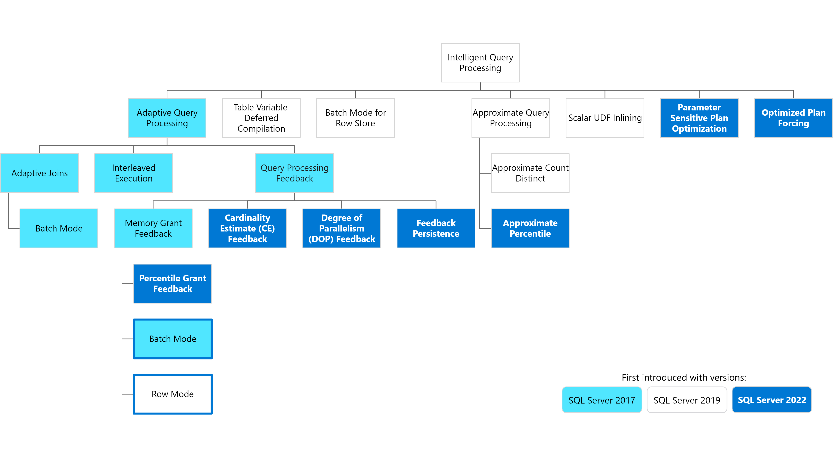
Source: https://learn.microsoft.com/en-us/sql/sql-server/what-s-new-in-sql-server-2022?view=sql-server-ver16#query-store-improvements

Slide 21
Intelligent Query Processing (IQP)
Next Generation
Degree of Parallelism (DOP) feedback
Cardinality Estimation (CE) feedback
Parameter Sensitive Plan (PSP) Optimization
Hints
Feedback store
Query Store
Resource: https://github.com/microsoft/sqlworkshops-sql2022workshop/tree/main/sql2022workshop/slides

Slide 22
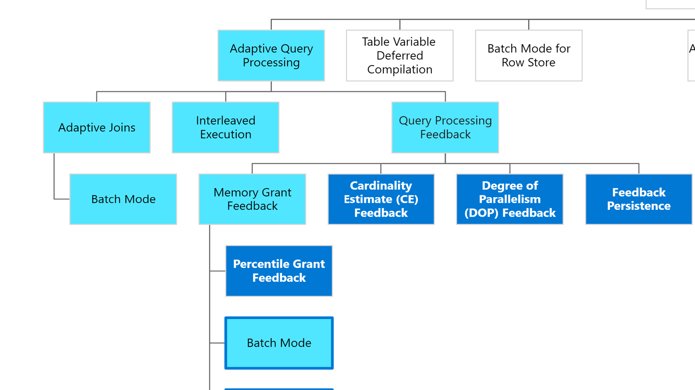


Slide 23
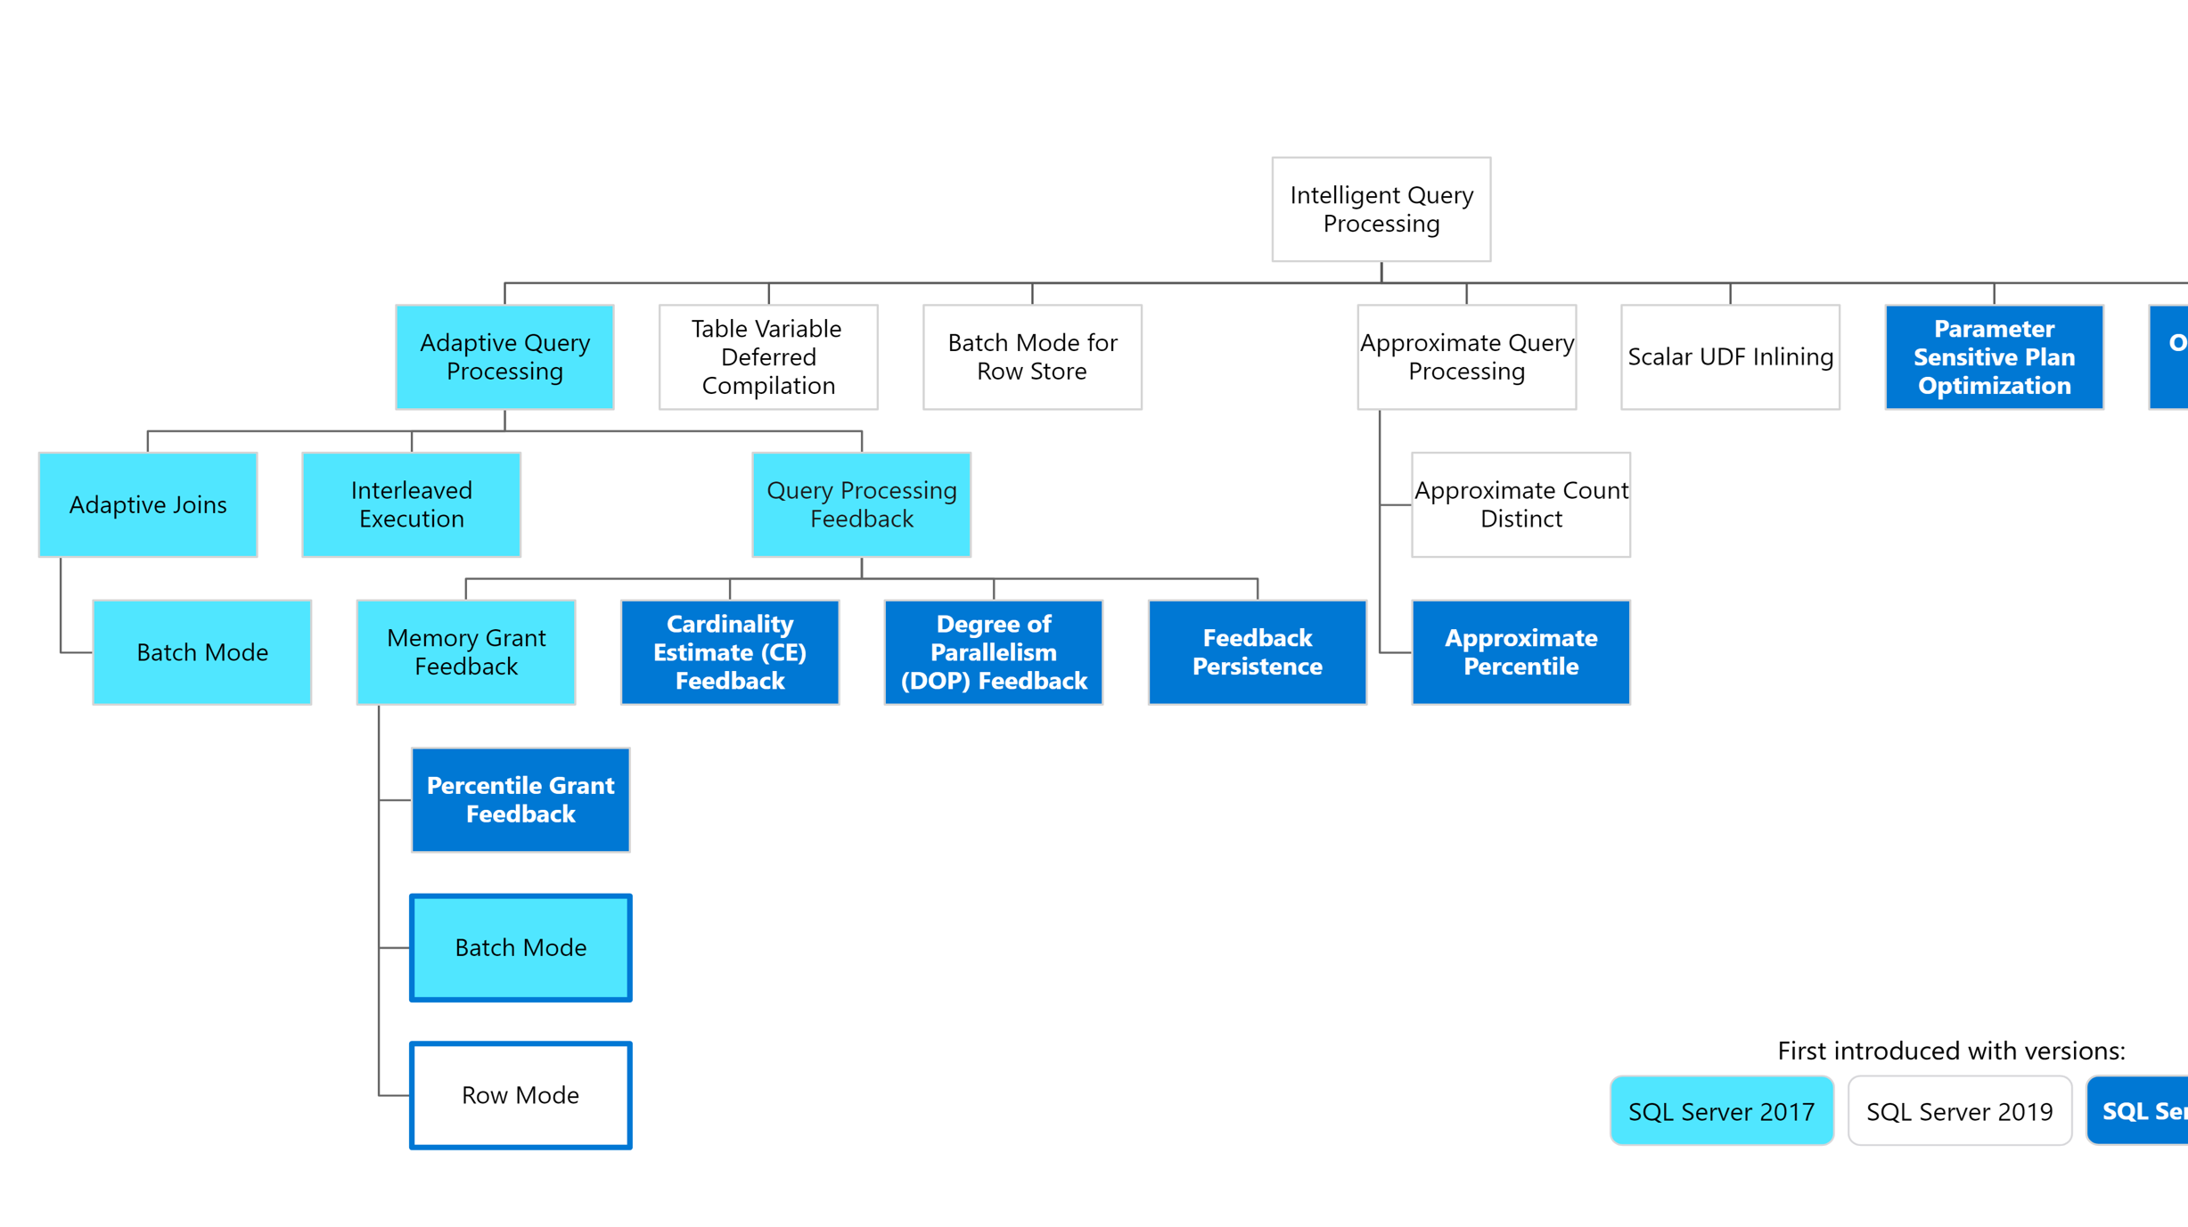

Slide 24
Source: https://learn.microsoft.com/en-us/sql/sql-server/what-s-new-in-sql-server-2022?view=sql-server-ver16#query-store-improvements

Slide 25
How a Query is Executed?
Query Optimization
Query
Transformation
Cardinality
Estimation
Costing
Plan Cache
Query Execution
Query
Plan Cache
Memory Grant
Query Execution

Slide 26
SQL Server 2022 – QS Advancements
Enabled by Default
Query Store data capture in secondary replica (preview)
Query Store hints
IQP features using Query Store
Parameter sensitive plan optimization
Memory grant feedback
Degree of parallelism (DOP) feedback
Cardinality estimation feedback
Optimized plan forcing

Slide 27
Highlights
No code changes – Works with latest Compatibility level
They work together (can have multiple features supporting query)
Large positive impact in performance

Slide 28
Query Store for Secondary Replicas

Slide 29
Query Store for Secondary Replicas
Sends data to Primary QS db
Enable Trace Flag 12606
Primary
Read/write
Read only secondary
Sends data to Primary QS db
Read only secondary
***Query Store for secondary replicas is available for preview. It isn't available for use in production environments.

Slide 30
Enable using T-SQL
1. First QS needs to be enabled on Primary replica database
ALTER DATABASE [Database_Name] SET QUERY_STORE = ON;
GO
ALTER DATABASE [Database_Name]
SET QUERY_STORE ( OPERATION_MODE = READ_WRITE );

Slide 31
Enable using T-SQL
2. Connect to Primary Replica and run on each desired database
ALTER DATABASE [Database_Name]
FOR SECONDARY SET QUERY_STORE = ON (OPERATION_MODE = READ_WRITE );
GO
3. To disable, connect to primary and run on each desired database
ALTER DATABASE [Database_Name]
FOR SECONDARY SET QUERY_STORE = OFF;
GO

Slide 32
How to Force/Unforce plans on Secondary
Optional plan scoped argument can be added
EXEC sp_query_store_force_plan 26012, 3, 2;
EXEC sp_query_store_unforce_plan 26012, 3, 2;
Plan Forcing Scope parameter
0 = Force on read-write replica (default)
1 = Force/unforce on all read-only replicas
2 = Force/unforce on all replicas
Resource: https://www.youtube.com/watch?v=BbaC6-2qsjI

Slide 33
Query Store Hints

Slide 34
Query Store Hints
Used for optimizing specific queries under specific conditions
SQL Server 2022, Azure SQL databases, elastic pools, managed instances, and hyperscale databases
Simple to fix without modifying underlining code
Query hints like MAXDOP, recompile, max/min memory grant size, compatibility level, etc.

Slide 35
Two Step Process
Get the query_id from catalog views
Stored procedure sp_query_store_set_hints
Example:
EXEC sp_query_store_set_hints @query_id=5, @value = N'OPTION(RECOMPILE)';

Slide 36
Things to Remember
Any query hints in your code will override
QS hints are persisted
Table hints are not supported

Slide 37
PSP – Parameter Sensitive Plan Optimization
Parameter Sniffing problem
Just change the compat level to 160
Multiple active plans were saved in cache for single parameterized statement
Based on different data sizes and the parameter value
Up to 3 out of all “at risk” parameterized predicates
Equality predicates and uses the statistics histograms

Slide 38
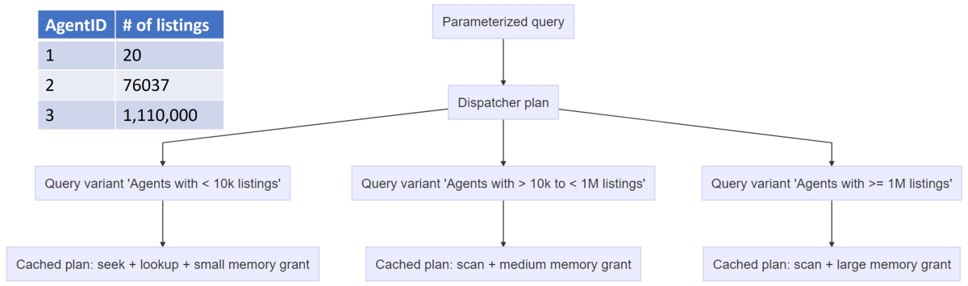
Logic for PSP
Resource: https://learn.microsoft.com/en-us/sql/relational-databases/performance/parameter-sensitive-plan-optimization?view=sql-server-ver16

Slide 39
Example
CREATE PROCEDURE dbo.Salesinformation @productID [int]
AS
BEGIN
SELECT [SalesOrderID]
,[ProductID]
,[OrderQty]
FROM [Sales].[SalesOrderDetailEnlarged]
WHERE [ProductID] = @productID;
END;

Slide 40
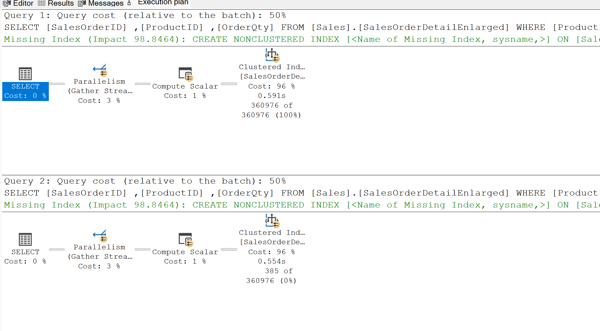
/* Executing the sp resulting in many rows with this parameter */
EXEC dbo.Salesinformation 870
/* This parameter will result in only couple of rows, it reuses the same execution plan */
EXEC dbo.Salesinformation 942
360K rows
385 rows

Slide 41
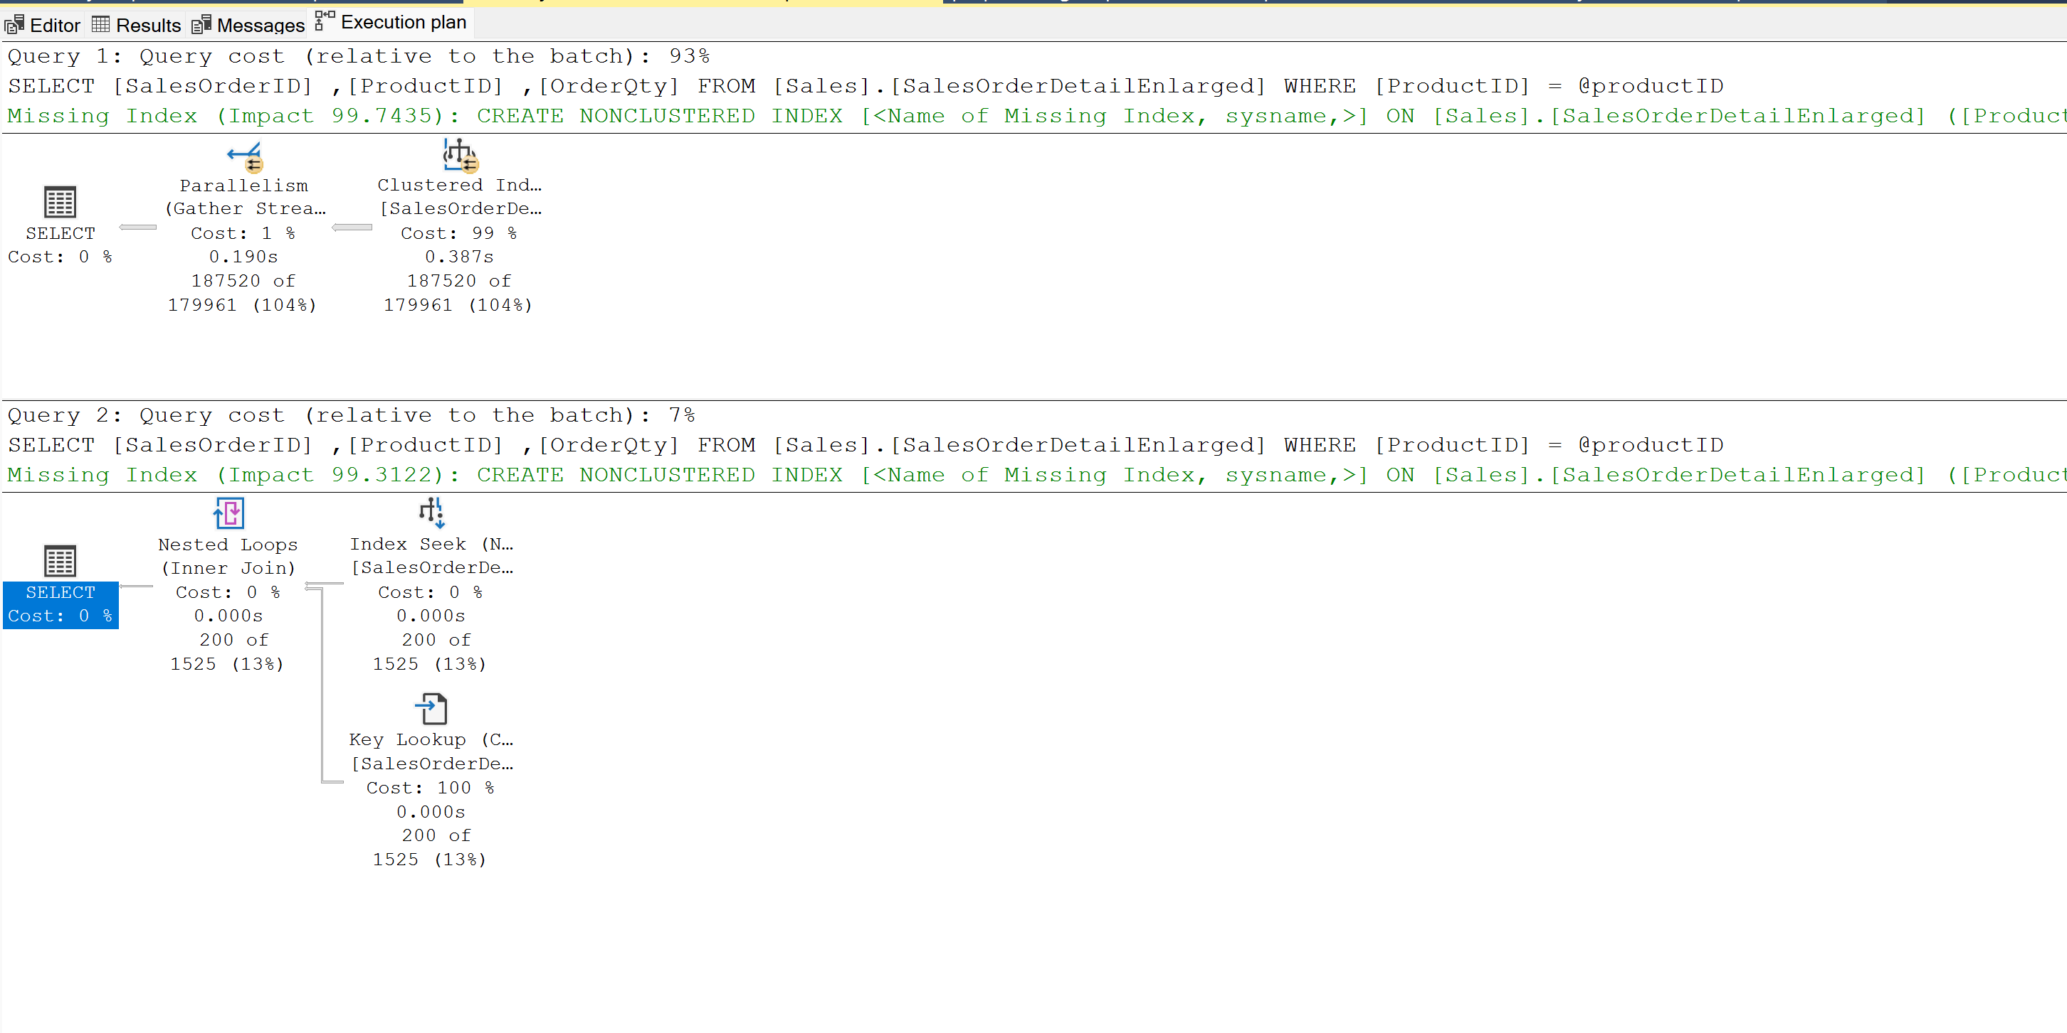
Changed the compat level to 160

Slide 42
Takeaways (1/4)
Cannot be disabled in Azure SQL Database single database and Elastic Pool
TF 7745 to avoid writing QS data to disk before SQL Server shutdown
TF 7752 enables asynchronous load of Query Store (default in SQL Server 2019)
Source: https://docs.microsoft.com/sql/relational-databases/performance/best-practice-with-the-query-store

Slide 43
Takeaways (2/4)
Natively compiled queries runtime stats
Enable sys.sp_xtp_control_query_exec_stats (not persisted, configure on every sql server restart)
If many unique ad-hoc queries, use Optimize for Ad hoc Workloads option to save cache memory
Source: https://docs.microsoft.com/sql/relational-databases/performance/monitoring-performance-by-using-the-query-store
https://docs.microsoft.com/sql/relational-databases/performance/best-practice-with-the-query-store

Slide 44
Takeaways (3/4)
Max plans per query is set as 200 execution plans per query by default
If MAX_STORAGE_SIZE_MB is reached, Query Store goes into read-only mode
Size Based Cleanup Mode to avoid changing to read only mode once max size is reached (90 percent of max_storage_size_mb)
Source: https://docs.microsoft.com/sql/relational-databases/system-catalog-views/sys-database-query-store-options-transact-sql
https://docs.microsoft.com/sql/relational-databases/performance/best-practice-with-the-query-store
https://docs.microsoft.com/sql/relational-databases/system-catalog-views/sys-database-query-store-options-transact-sql

Slide 45
Takeaways (4/4)
Auto mode (avoids ad-hoc queries with small resource consumption)
QS QUERY_CAPTURE_MODE to AUTO is recommended (Default in Azure SQL Database,SQL Server 2019)
Source: https://docs.microsoft.com/sql/relational-databases/performance/best-practice-with-the-query-store

Slide 46
Memory Grant Feedback

Slide 47
Memory Grant Feedback
Query processing feedback - Uses historical data about a query's execution to decide.
Remembers the memory info from previous executions
Percentile feedback - multiple past executions

Slide 48
Resources
Monitor performance by using the Query Store
Intelligent query processing in SQL databases
Best practices for monitoring workloads with Query Store
Azure SQL & SQL Server 2022: Intelligent Database Futures

Slide 49
Thank you!
Twitter: @dbanuggets
Blog: https://dbanuggets.com/
Linkedin: https://www.linkedin.com/in/deepthigoguri/

